Slide 1



Kubernetes Master Course I
Homework dn.dev/kube-tutorial
dn.dev/kubemaster1

Slide 2
Upcoming DevNation Schedule
 | India (English) UTC: 9:30 Local 15:00 | France (French) UTC 11:00 Local 13:00 | Spain (Spanish) UTC 13:00 Local 15:00 | Brazil (Portuguese) UTC 14:00 Local 11:00 | USA (English) UTC 16:00 Local 12:00 Eastern | Mexico (Spanish) UTC 18:00 Local 13:00 Central Standard
April 6 2020 |  |  |  | Kubernetes I | Kubernetes I
April 7 2020 |  |  |  | Kubernetes 2 | Kubernetes 2
April 9 2020 |  |  |  |  | Tech Talk Thursday
April 13 2020 | Kubernetes 1 | Kubernetes 1 | Kubernetes 1
April 14 2020 | Kubernetes 2 | Kubernetes 2 | Kubernetes 2
April 16 2020 |  |  |  |  | Tech Talk Thursday
April 20 2020 | Istio | Istio | Istio | Istio | Istio
April 21 2020 | Knative | Knative | Knative | Knative | Knative
April 22 2020 | Tekton | Tekton | Tekton | Tekton | Tekton
April 23 2020 |  |  |  |  | Tech Talk Thursday
Notes:
https://www.timeanddate.com/worldclock/meetingtime.html?month=4&day=20&year=2020&p1=438&p2=195&p3=31&p4=233&p5=179&p6=155&iv=0

Slide 3
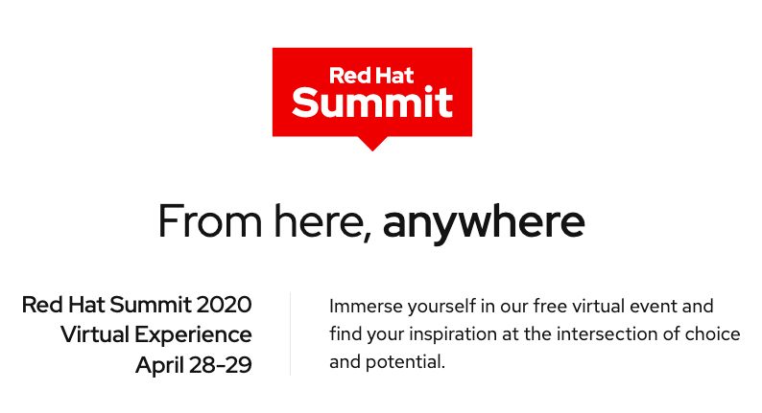
Learn more

Slide 4

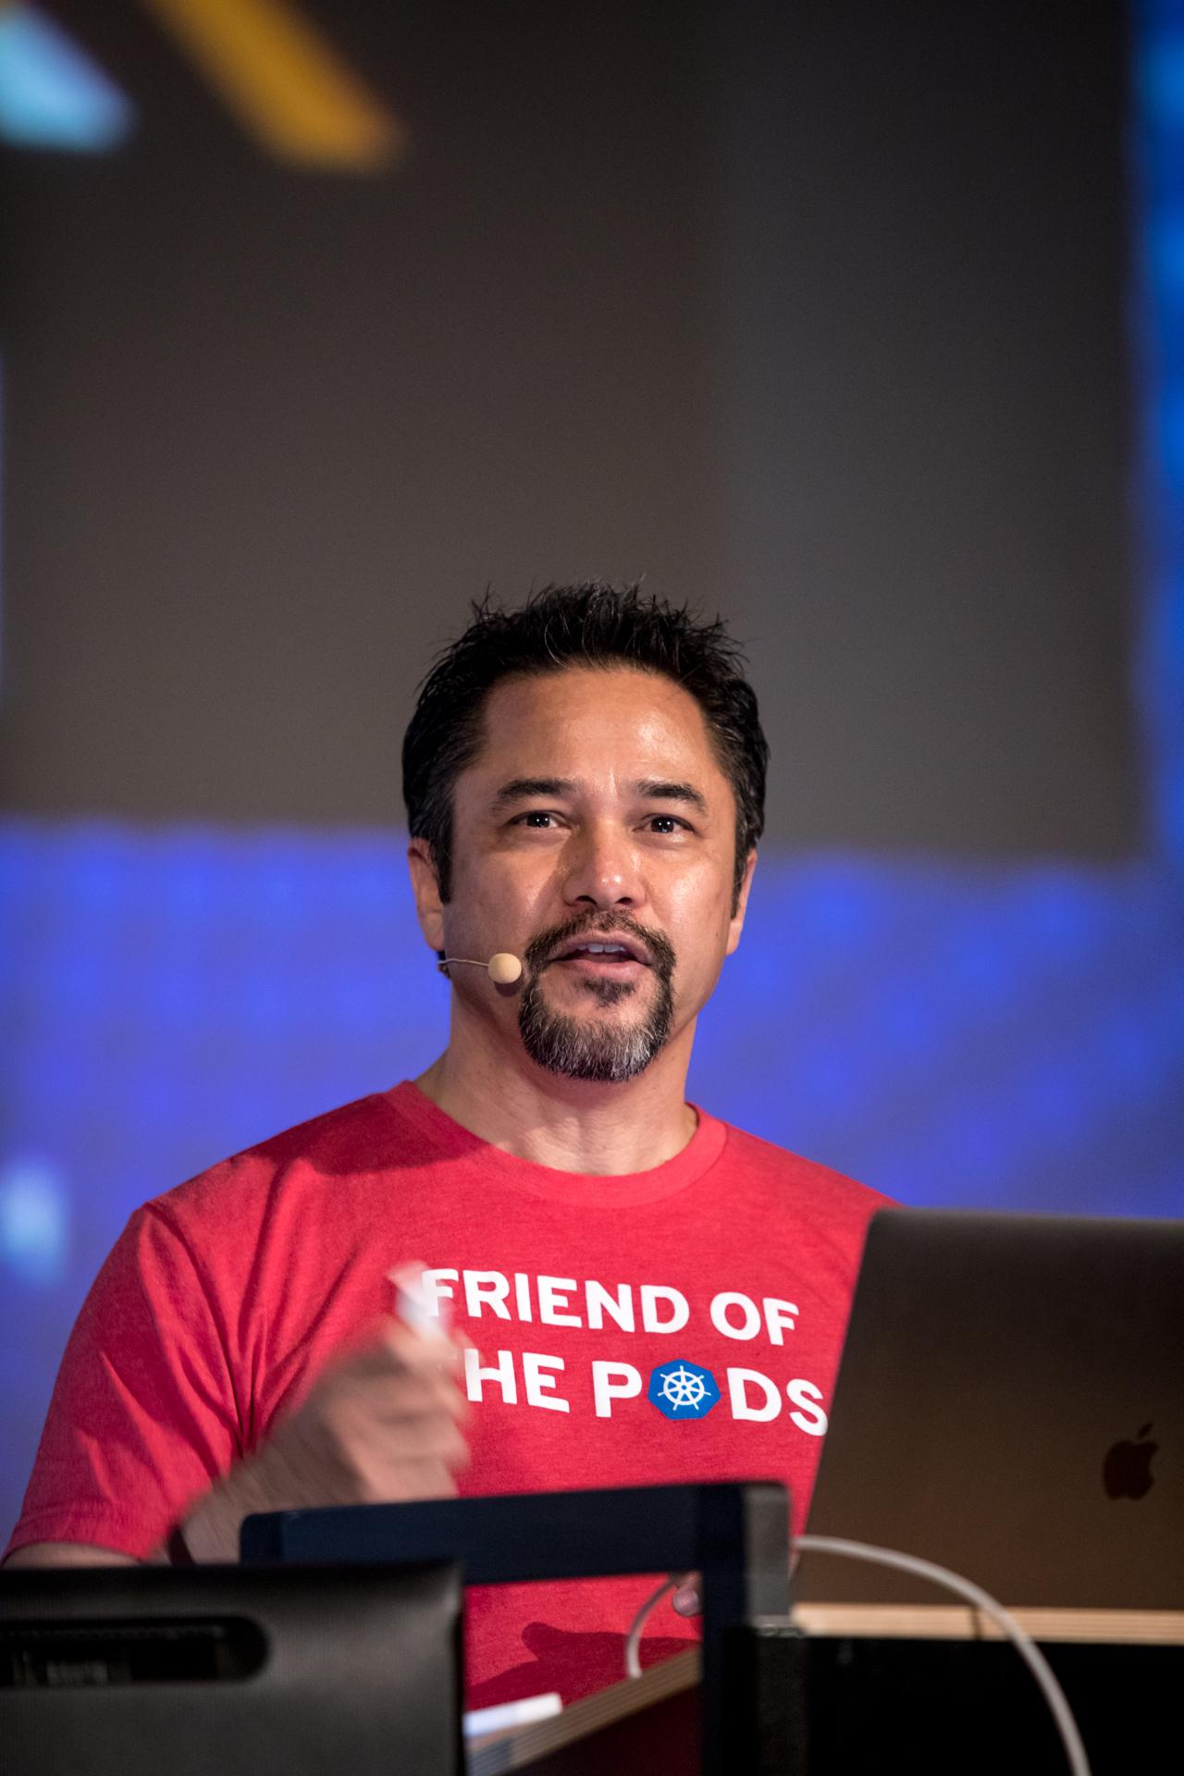
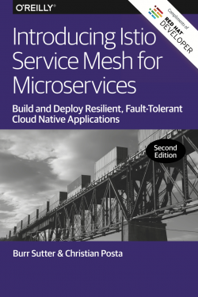


@burrsutter
burr@redhat.com
Featured speaker at technology events around the globe
Java Champion since 2005
Former President of the Atlanta Java User Group
Founded the DevNexus conference
Always looking for technologies that enable developers to deliver better software ever faster
Notes:
https://www.youtube.com/watch?v=DOqNhPsNap8
https://www.youtube.com/watch?v=pjkSIWSuZTM
https://www.youtube.com/watch?v=ZpbXSdzp_vo

Slide 5
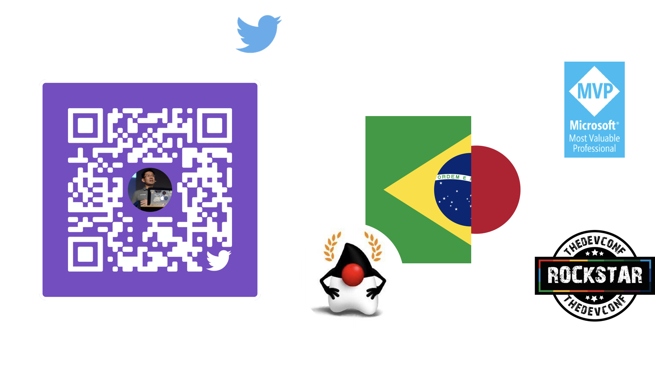
@yanaga

Slide 6


Survey Link
https://www.surveymonkey.com/r/2J9LDK7

Slide 7


Kamesh Sampath(devadvocate.yaml)
apiVersion: bio/v1
kind: DeveloperAdvocate
spec:
title: “Director of Developer Experience @ Red Hat”
gde:
expert: cloud
year: 2019
javaDeveloper: true
opensourceContributions:
- Eclipse Che
- Quarkus - Supersonic Subatomic Java
- kubernetes/minikube: Run Kubernetes locally
- Camel K
social-handles:
linkedin: https://linkedin.com/in/kameshsampath
github: kameshsampath (Kamesh Sampath)
twitter: Kamesh Sampath (@kamesh_sampath)
blogs: developers.redhat.com(Kamesh Sampath)
kubectl email --address kameshs@redhat.com

Slide 8


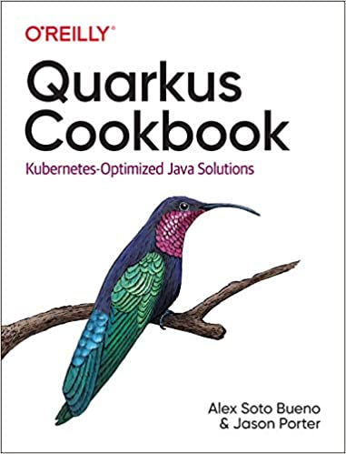
Alex Soto (lordofthejars.com)
@alexsotob
asotobue@redhat.com
Currently Red Hat’s Director of Developer Experience
Featured speaker at technology events around the globe
A Java Champion since 2017
Writer, University Professor, Radio collaborator
A big fan of testing and continuous delivery in 21st century

Slide 9

Sebastien Blanc
@sebi2706
sblanc@redhat.com
Currently Red Hat’s Director of Developer Experience
Featured speaker at technology events around the globe
Java Champion
Co-organizer of Riviera DEV
Passion-Driven-Developer with one goal : share his passion by giving talks that are pragmatic, fun and focused on live coding

Slide 10
Agenda
Master Course I
Why Kubernetes
What is Kubernetes
Installation
kubectl
Pod
ReplicaSet
Deployment
logs, stern
Debugging with exec
Apps as a Service
Rolling Updates
Master Course 2
Building Images
Resource Limits
Live & Ready
Service Magic
Blue/Green
Env & ConfigMap
Secrets
Custom Resource Definitions
Pizzas & Apache Kafkas

Slide 11
Why Kubernetes?

Slide 12
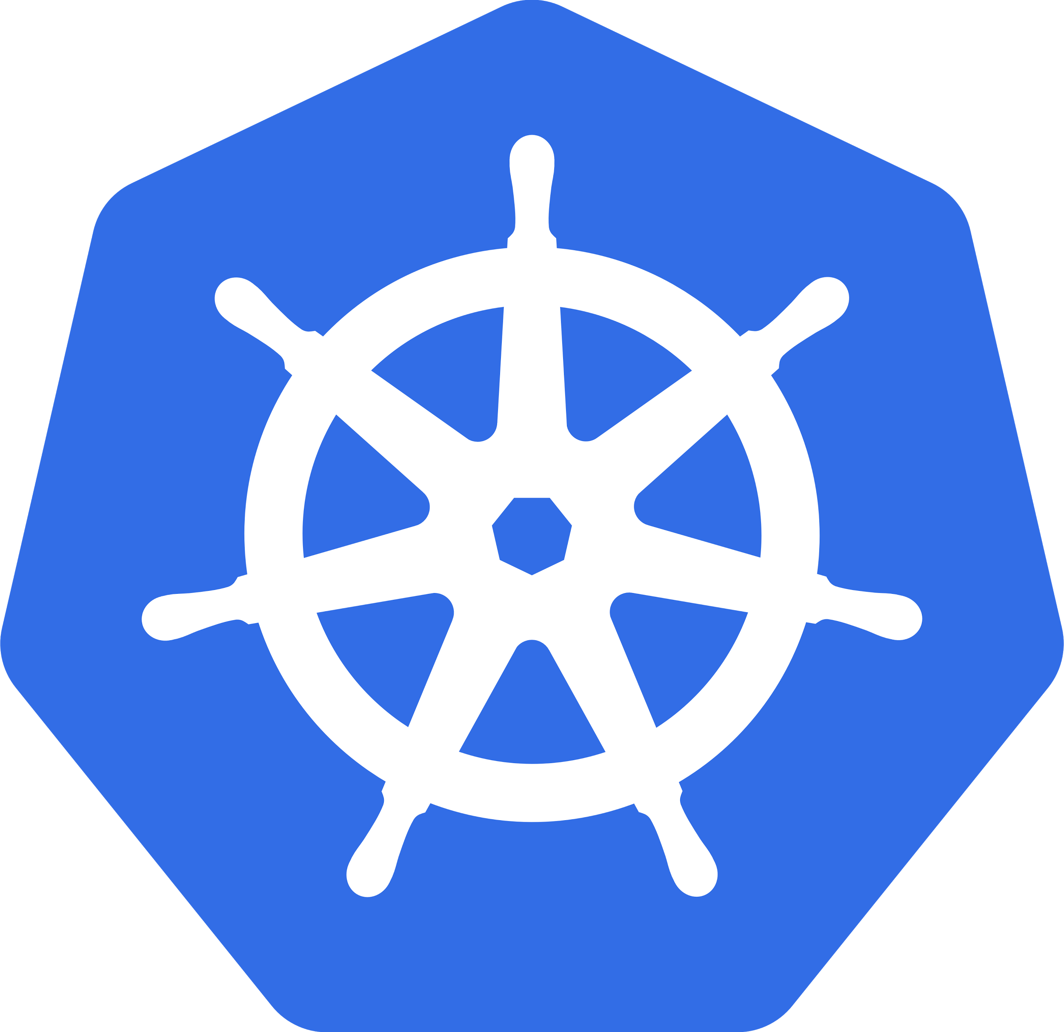

Old School New School
Love Thy Mono

Slide 13
A Challenge
Have you ever had “/” vs “\” break your app? Or perhaps needed a unique version of a JDBC driver? Or had a datasource with a slightly misspelled JNDI name? Or received a patch for the JVM or app server that broke your code?
.war or .ear
Custom Configuration
JDBC driver, datasource, JMS queue, users
Containerize
Your
App
Application Server
Weblogic 10.x.y, Tomcat 6.x.y, JBoss EAP 6.x.y
Java Virtual Machine
Java 1.6.6_45 or Java 1.7.0_67
Operating System
Linux Kernel Version & Distribution
Server Hardware

Slide 14
Email
MyApp.war has been tested with the following
On my Windows 7 desktop
JDK 1.8.43
Wildfly 9
Configuration:
Datasource: MySQLDS
Tested with: mysql-connector-java-5.1.31-bin.jar
Production Environment
Red Hat Enterprise Linux 6.2
JRE 1.7.3
WebSphere 8.5.5
Oracle 9

Slide 15
Dockerfile
Container Guest OS
FROM centos/wildfly
COPY xyz.xml /opt/myserver/configuration/
COPY mysql-connector-java-5.1.31-bin.jar /opt/wildfly/standalone/deployments/ COPY mysql-sample-ds.xml /opt/wildfly/standalone/deployments/
COPY myapp/target/your.war /opt/wildfly/standalone/deployments/
Java App Server
custom configuration
dependencies
your.war

Slide 16






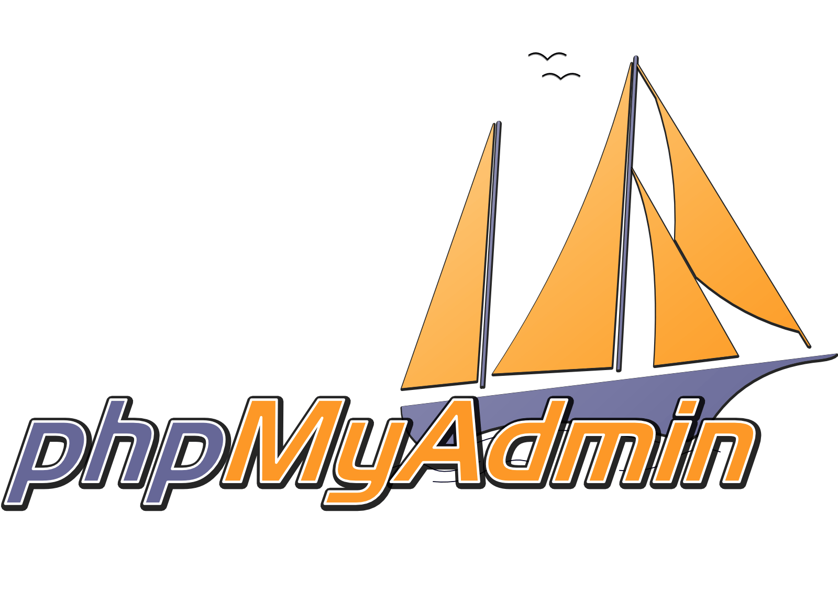
DevOps Challenges for Multiple Containers
How to scale?
How to avoid port conflicts?
How to manage them on multiple hosts?
What happens if a host has trouble?
How to keep them running?
How to update them?
Rebuild Container Images?
Node
Node
Node
Node
Node
Node
Logger

Slide 17
Learn more
Notes:
Kubernetes supports a microservices architecture through the Service construct, typically the functionalities are abstracted in Pods and exposed as "Service" - which has name attached to it and can be called like API using the name. Kubernetes "Services" also does some rudimentary load balancing

Slide 18
Meet Kubernetes
Greek for “Helmsman,” also the root of the word “Governor” (from latin: gubernator)
Container orchestrator
Supports multiple cloud and bare-metal environments
Inspired by Google’s experience with containers
Open source, written in Go
Manage applications, not machines

Slide 19
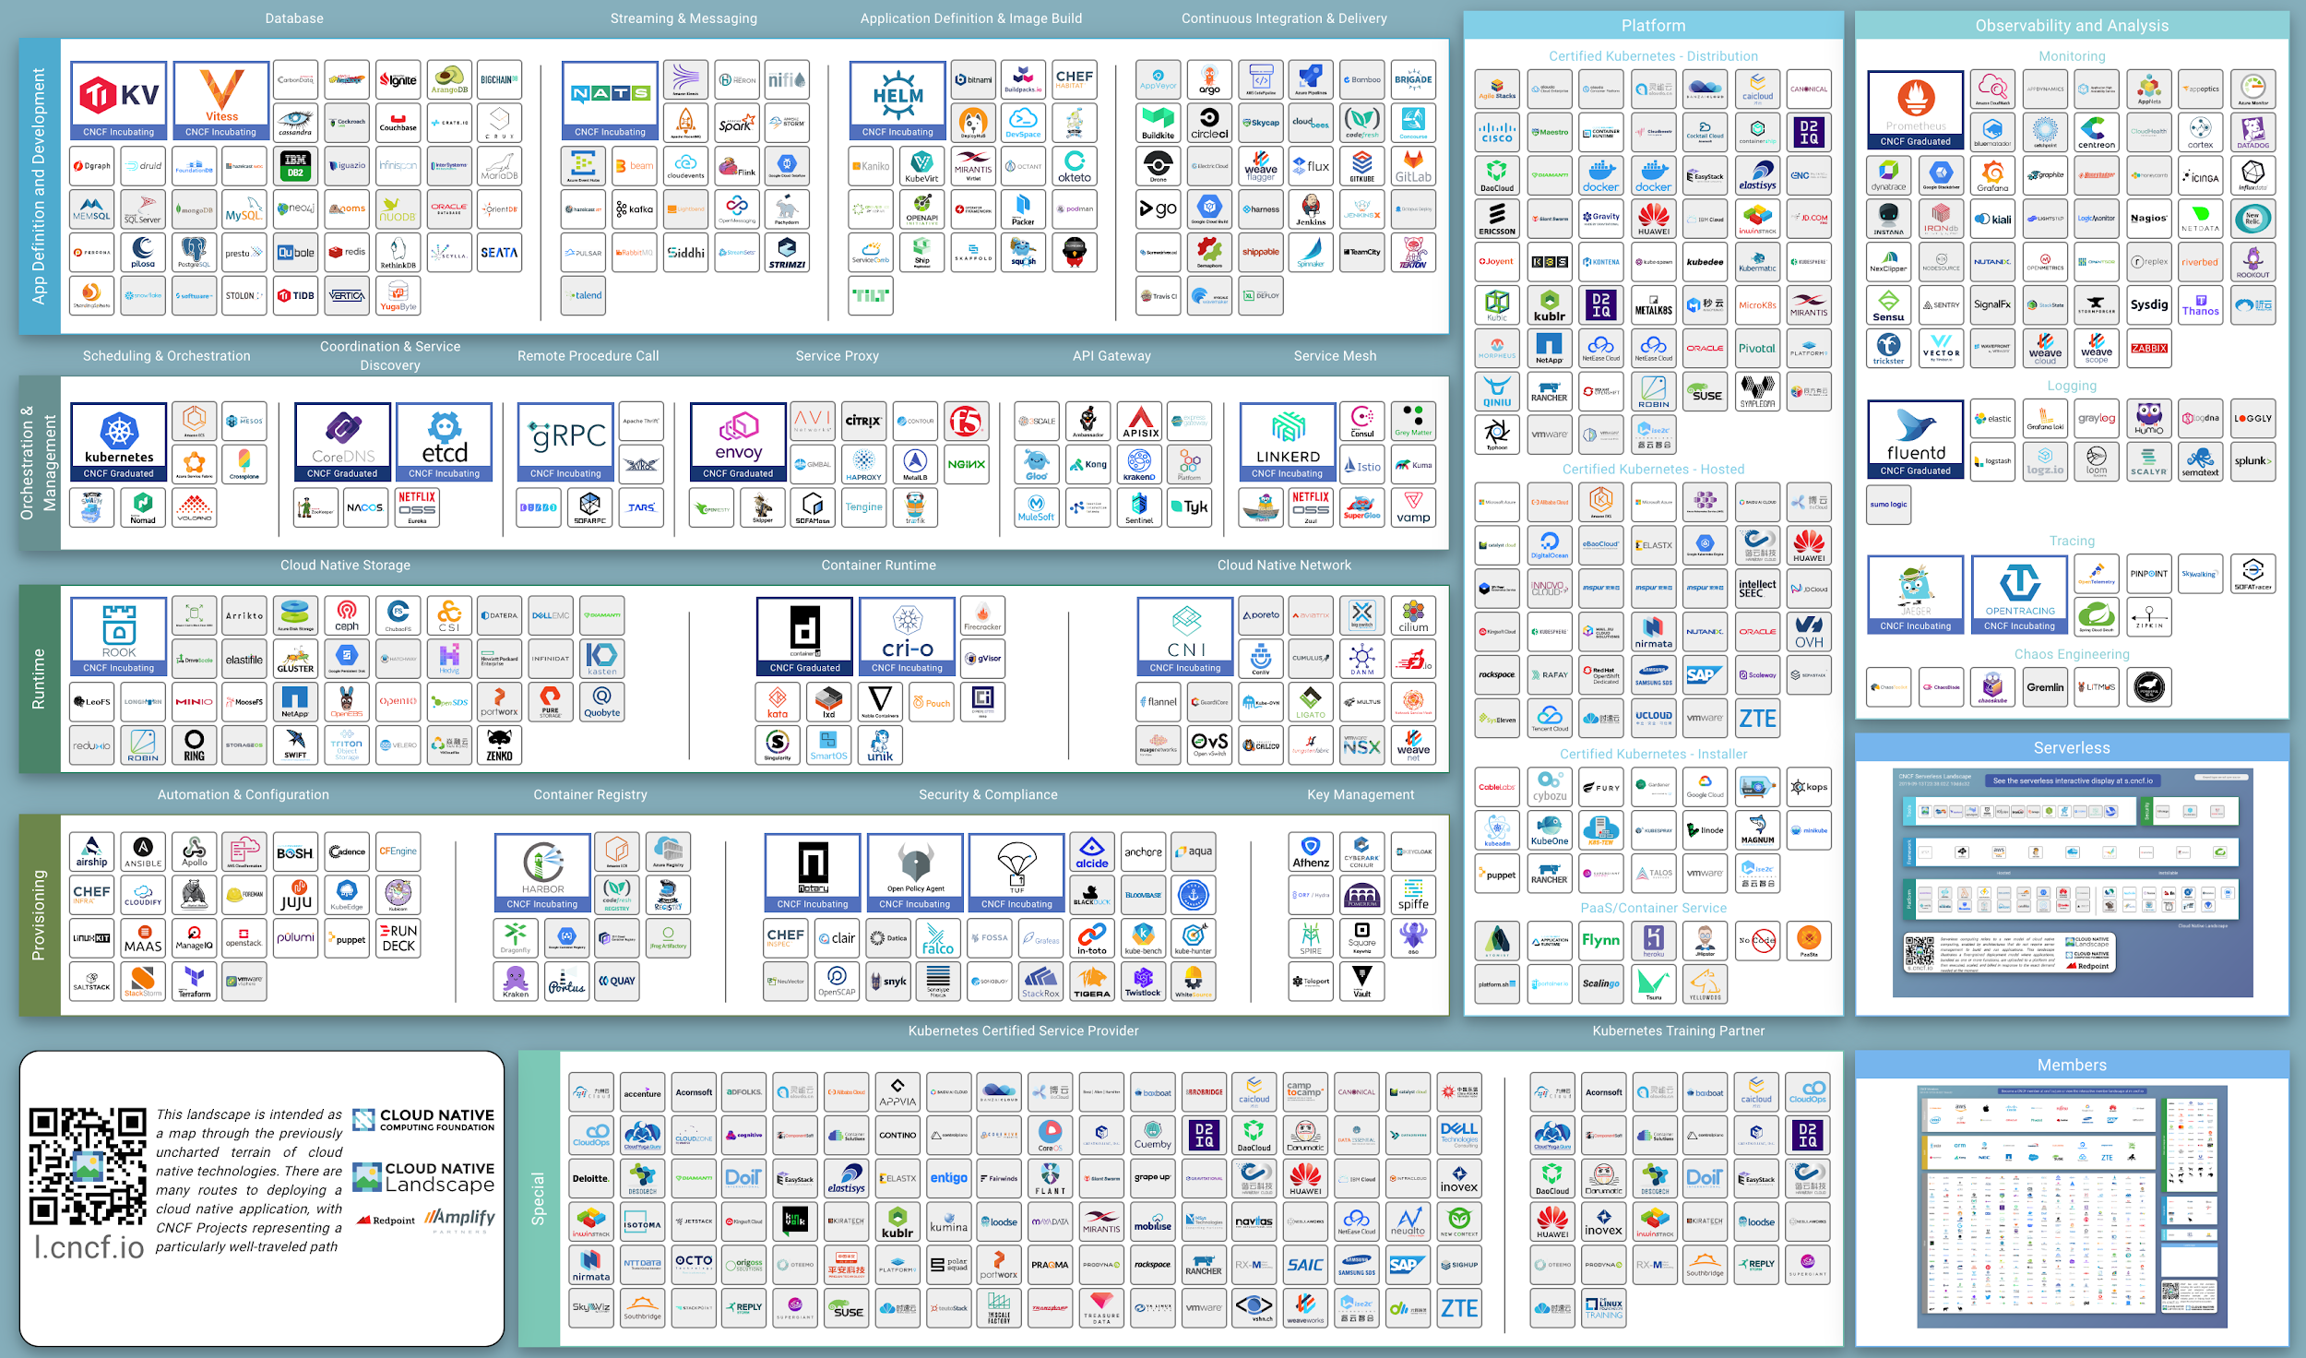

Slide 20
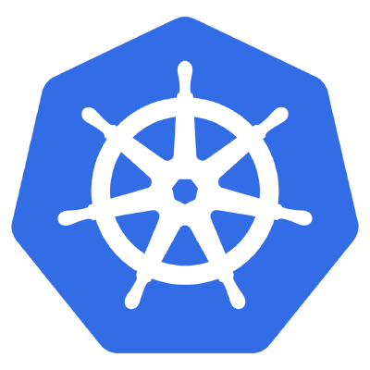
History of Microservices
AWS EC2
2006
Java EE6
2009
DropWizard
May 2011
Hystrix
March 2012
Eureka
July 2012
Spring Boot
Sept 2013
Kubernetes
June 2014
2
0
1
5
Continuous
Integration
via XP
1999
DevOps
2009
NETFLIX
to AWS
2010
Agile
Manifesto
Feb
2001
Vert.x
June 2011
Ribbon
March 2012
Microservices
Assess
Thoughtworks
Radar
March 2012
Docker
March
2013
Microservices
Defined
Thoughtworks
Fowler, Lewis
March 2014
Notes:
https://www.infoq.com/presentations/SpringOne-2GX-Keynote-Next-Generation-Applications (advance to 1:05)
http://redmonk.com/sogrady/2014/03/27/micro-services/
https://www.slideshare.net/adriancockcroft/speeding-up-31799721
https://en.wikipedia.org/wiki/Java_EE_version_history#Java_EE_6_.28December_10.2C_2009.29
https://assets.thoughtworks.com/assets/technology-radar-march-2012.pdf
Netflix and Kubernetes https://www.youtube.com/watch?v=57UK46qfBLY&feature=youtu.be&t=37m21s
https://thenewstack.io/github-goes-kubernetes-tells/
Docker born March 2013
https://www.youtube.com/watch?v=9xciauwbsuo

Slide 21
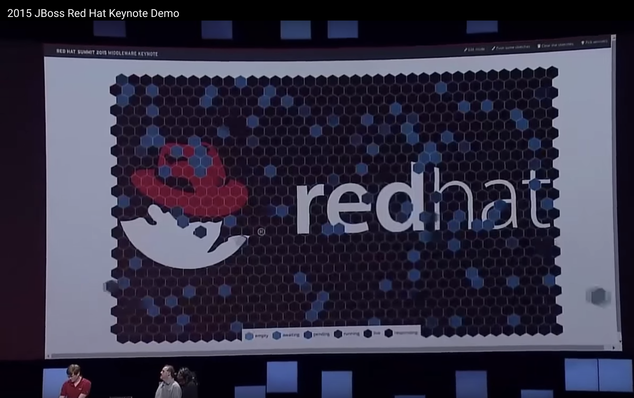
2015
Launch 1000+
Containers
Audience
Claims a Container
https://www.youtube.com/watch?v=GCtpncA0Ea0&feature=youtu.be&t=1031

Slide 22
What is Kubernetes?

Slide 23
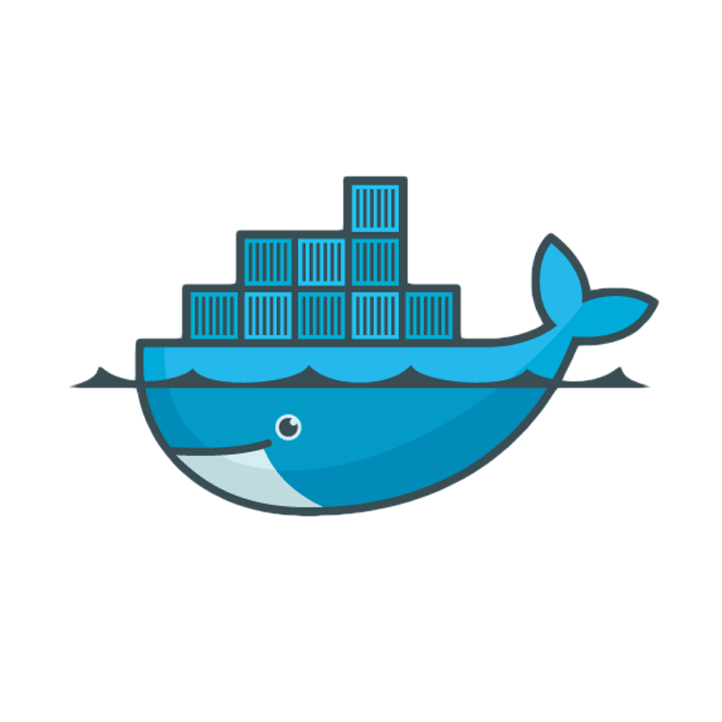
Pods
A group of whales is commonly referred to as a pod and a pod usually consists a group of whales that have bonded together either because of biological reasons or through friendships developed between two or more whales.
In many cases a typical whale pod consists of anywhere from 2 to 30 whales or more.*
*http://www.whalefacts.org/what-is-a-group-of-whales-called/
Notes:
https://kubernetes.io/docs/concepts/workloads/pods/pod/

Slide 24


Kubernetes Terms
Pod
Replicaset/
Deployment
Service
Persistent
Volume
Label
1+ containers
Shared IP
Shared storage (ephemeral)
Shared resources
Shared lifecycle
The Desired State - replicas, pod template: health checks, resources, image
Grouping of pods (acting as one) has stable virtual IP and DNS name
Network available storage
PVs and PVCs
Key/Value pairs associated with Kubernetes objects (env=production)

Slide 25



Kubernetes Cluster - Nodes
Node
kubelet
Node
kubelet
Node
kubelet
Master
Dev
api
etcd
scheduler
Node
kubelet
Node
kubelet
Node
kubelet
controllers
Istio proxy
Ops
Notes:
https://kubernetes.io/docs/tasks/administer-cluster/configure-upgrade-etcd/

Slide 26
Kubernetes Cluster - Declarative
Node
kubelet
Node
kubelet
Node
kubelet
Master
Dev
api
image: repo/mytomcat:v1
replicas: 4
etcd
scheduler
Node
kubelet
Node
kubelet
Node
kubelet
controllers
Istio proxy
Ops
Notes:
https://kubernetes.io/docs/tasks/administer-cluster/configure-upgrade-etcd/

Slide 27
Kubernetes Cluster - 4 Tomcats
Node
kubelet
Node
kubelet
Node
kubelet
Master
Dev
api
etcd
scheduler
Node
kubelet
Node
kubelet
Node
kubelet
controllers
Istio proxy
Ops
Notes:
https://kubernetes.io/docs/tasks/administer-cluster/configure-upgrade-etcd/

Slide 28
Kubernetes Cluster - Pod Fail
Node
kubelet
Node
kubelet
Node
kubelet
Master
X
Dev
api
etcd
scheduler
Node
kubelet
Node
kubelet
Node
kubelet
controllers
Istio proxy
Ops
Notes:
https://kubernetes.io/docs/tasks/administer-cluster/configure-upgrade-etcd/

Slide 29
Kubernetes Cluster - Correcting
Node
kubelet
Node
kubelet
Node
kubelet
Master
Dev
api
etcd
scheduler
Node
kubelet
Node
kubelet
Node
kubelet
controllers
Istio proxy
Ops
Notes:
https://kubernetes.io/docs/tasks/administer-cluster/configure-upgrade-etcd/

Slide 30
Kubernetes Cluster - Node Fail
Node
kubelet
Node
kubelet
Node
kubelet
Master
X
Dev
api
etcd
scheduler
Node
kubelet
Node
kubelet
Node
kubelet
controllers
Istio proxy
Ops
Notes:
https://kubernetes.io/docs/tasks/administer-cluster/configure-upgrade-etcd/

Slide 31
Kubernetes Cluster - Pods Replaced
Node
kubelet
Node
kubelet
Master
Dev
api
etcd
scheduler
Node
kubelet
Node
kubelet
Node
kubelet
controllers
Istio proxy
Ops

Slide 32
Kubernetes Cluster - New Node
Node
kubelet
Node
kubelet
Node
kubelet
Master
Dev
api
etcd
scheduler
Node
kubelet
Node
kubelet
Node
kubelet
controllers
Istio proxy
Ops
Notes:
https://kubernetes.io/docs/tasks/administer-cluster/configure-upgrade-etcd/

Slide 33
Labels

Slide 34
Labels
App: Cool
Env: Dev
Version: 2.0
App: Cool
Env: Dev
Version: 1.0
Node
Node
Logger
App: Cool
Env: Prod
Version: 1.0
Node
Node
App: Cool
Env: Prod
Version: 2.0

Slide 35
Labels App:Cool
App: Cool
Env: Dev
Version: 2.0
App: Cool
Env: Dev
Version: 1.0
Node
Node
Logger
App: Cool
Env: Prod
Version: 1.0
Node
Node
App: Cool
Env: Prod
Version: 2.0

Slide 36
Labels Env:Dev
App: Cool
Env: Dev
Version: 2.0
App: Cool
Env: Dev
Version: 1.0
Node
Node
Logger
App: Cool
Env: Prod
Version: 1.0
Node
Node
App: Cool
Env: Prod
Version: 2.0

Slide 37
Labels Env:Prod
App: Cool
Env: Dev
Version: 2.0
App: Cool
Env: Dev
Version: 1.0
Node
Node
Logger
App: Cool
Env: Prod
Version: 1.0
Node
Node
App: Cool
Env: Prod
Version: 2.0

Slide 38
Labels Version:1.0
App: Cool
Env: Dev
Version: 2.0
App: Cool
Env: Dev
Version: 1.0
Node
Node
Logger
App: Cool
Env: Prod
Version: 1.0
Node
Node
App: Cool
Env: Prod
Version: 2.0

Slide 39
Installation
https://redhat-developer-demos.github.io/kubernetes-tutorial/kubernetes-tutorial/installation.html

Slide 40
Kubernetes Options
Localhost Development
minikube (kubectl) (docs)
Docker for Mac/Windows
CodeReady Containers
K3s
Micro8ks
KinD
Hosted Kubernetes Cluster
openshift.com/try from Red Hat
GKE from Google Cloud Platform
AKS from Microsoft Azure
EKS from Amazon Web Services
IKS from IBM Cloud
Digital Ocean
Roll-your-own with kubeadm
Many others

Slide 41
Developer Tools
bash: documented commands are based on bash
docker or podman: build images
git: pull resources from github
JDK & Apache Maven: if you wish to compile Java
curl, tar: downloading and unpacking installations
Homebrew for Mac: package installation tool
kubectl: the primary tool you will be using
minikube: on-laptop, single-node Kubernetes cluster

Slide 42
kubectl

Slide 43
kubectl commands
https://kubernetes.io/docs/user-guide/kubectl/
https://kubernetes.io/docs/reference/kubectl/cheatsheet
kubectl get namespaces
kubectl get pods -n mynamespace
kubectl run myboot --image=quay.io/burrsutter/myboot:v1 --port=8080
kubectl logs myboot-75f94d76fc-pl2l7
kubectl expose deployment --port=8080 myboot --type=LoadBalancer
kubectl scale deployment myboot --replicas=3
kubectl set image deployment myboot myboot=quay.io/burrsutter/myboot:v2
Notes:
https://kubernetes.io/docs/reference/kubectl/cheatsheet/

Slide 44
kubectl Exercises
https://redhat-developer-demos.github.io/kubernetes-tutorial/kubernetes-tutorial/kubectl.html

Slide 45
Pod, ReplicaSet, Deployment

Slide 46
Pod, ReplicaSet, Deployment Exercises
https://redhat-developer-demos.github.io/kubernetes-tutorial/kubernetes-tutorial/pod-rs-deployment.html

Slide 47
Service

Slide 48
Service Exercises
https://redhat-developer-demos.github.io/kubernetes-tutorial/kubernetes-tutorial/service.html

Slide 49
Logs

Slide 50
logs
System.out.println("Java, where am I?"); Or console.log("Node logs");
kubectl get pods kubectl logs microspringboot1-2-nz8f8 kubectl logs microspringboot1-2-nz8f8 -p # last failed pod
OR stern (brew install stern) https://github.com/wercker/stern stern myboot
OR kail (https://github.com/boz/kail) kail -d myboot

Slide 51
Logs Exercises
https://redhat-developer-demos.github.io/kubernetes-tutorial/kubernetes-tutorial/logs.html

Slide 52
Resource Limits

Slide 53
Resource Requests/Limits
resources:
requests:
memory: "300Mi"
cpu: "250m" # 1/4 core
limits:
memory: "400Mi"
cpu: "1000m" # 1 core

Slide 54
Resource Limits Exercises
https://redhat-developer-demos.github.io/kubernetes-tutorial/kubernetes-tutorial/resources.html

Slide 55
exec

Slide 56
kubectl exec
"ssh" into your containers and explore
kubectl get pods --namespace=microworld kubectl exec -it --namespace=microworld $POD cat /sys/fs/cgroup/memory/memory.limit_in_bytes Or kubectl exec -it --namespace=microworld microspringboot1-2-nz8f8 /bin/bash ps -ef | grep java Note: the following apply if using the fabric8 generated image, otherwise consult your Dockerfile java -version javac -version # now find that fat jar find / -name *.jar cd /deployments (based on use of the fabric8 maven plugin) ls exit

Slide 57
exec Exercises
https://redhat-developer-demos.github.io/kubernetes-tutorial/kubernetes-tutorial/exec.html

Slide 58
Rolling Updates

Slide 59
Rolling Update Exercises
https://redhat-developer-demos.github.io/kubernetes-tutorial/kubernetes-tutorial/rolling-updates.html

Slide 60
Free Resources

Slide 61
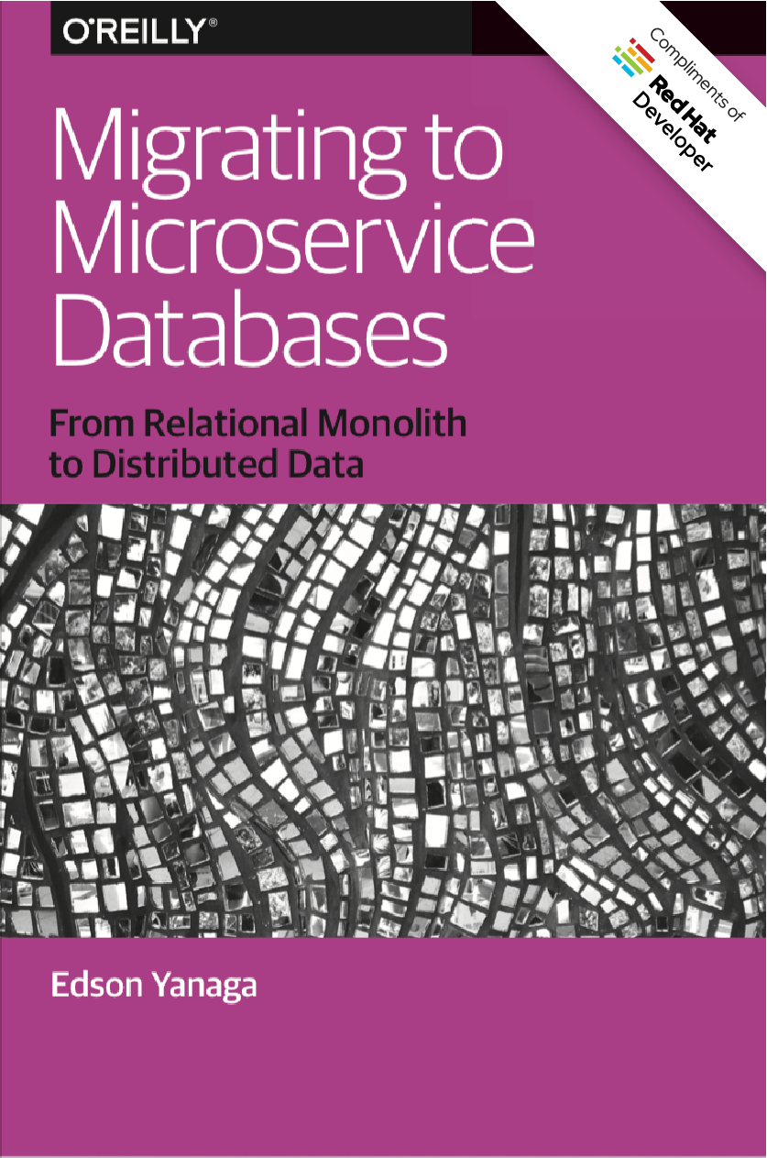
Download
http://bit.ly/mono2microdb

Slide 62
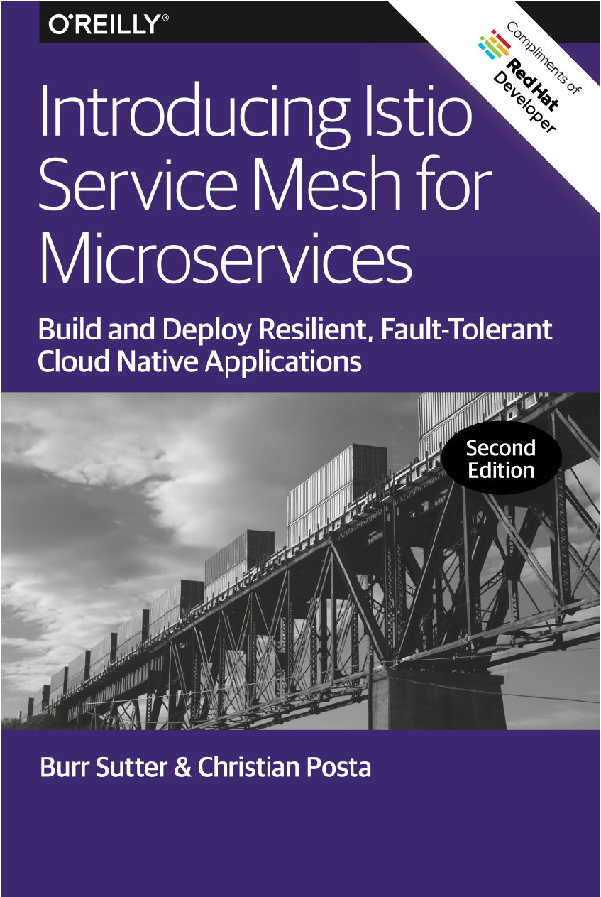
Download
bit.ly/istiobook

Slide 63
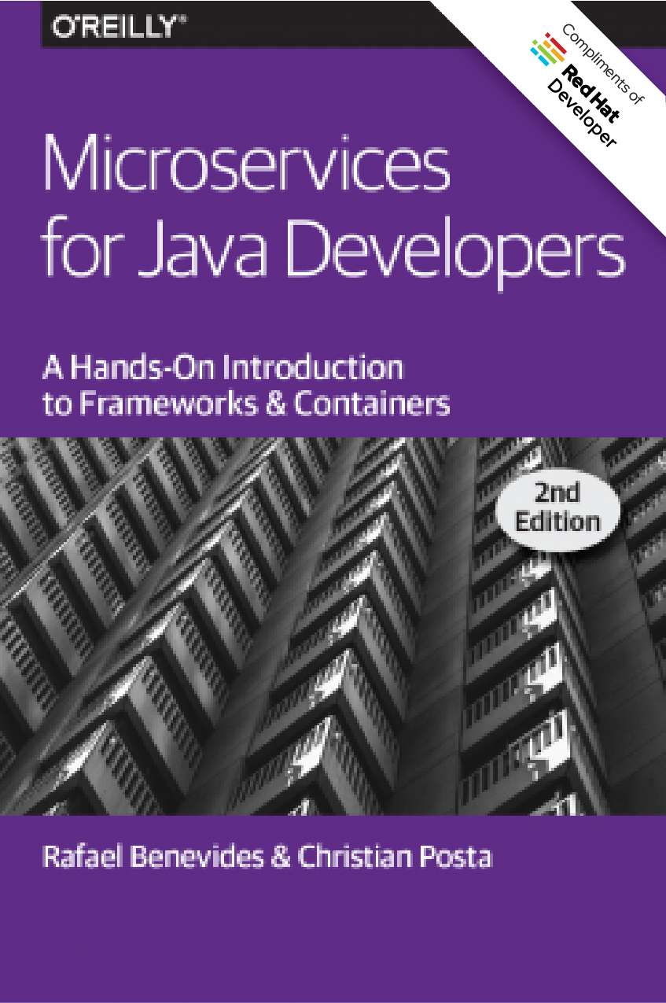
Download
bit.ly/javamicroservicesbook

Slide 64
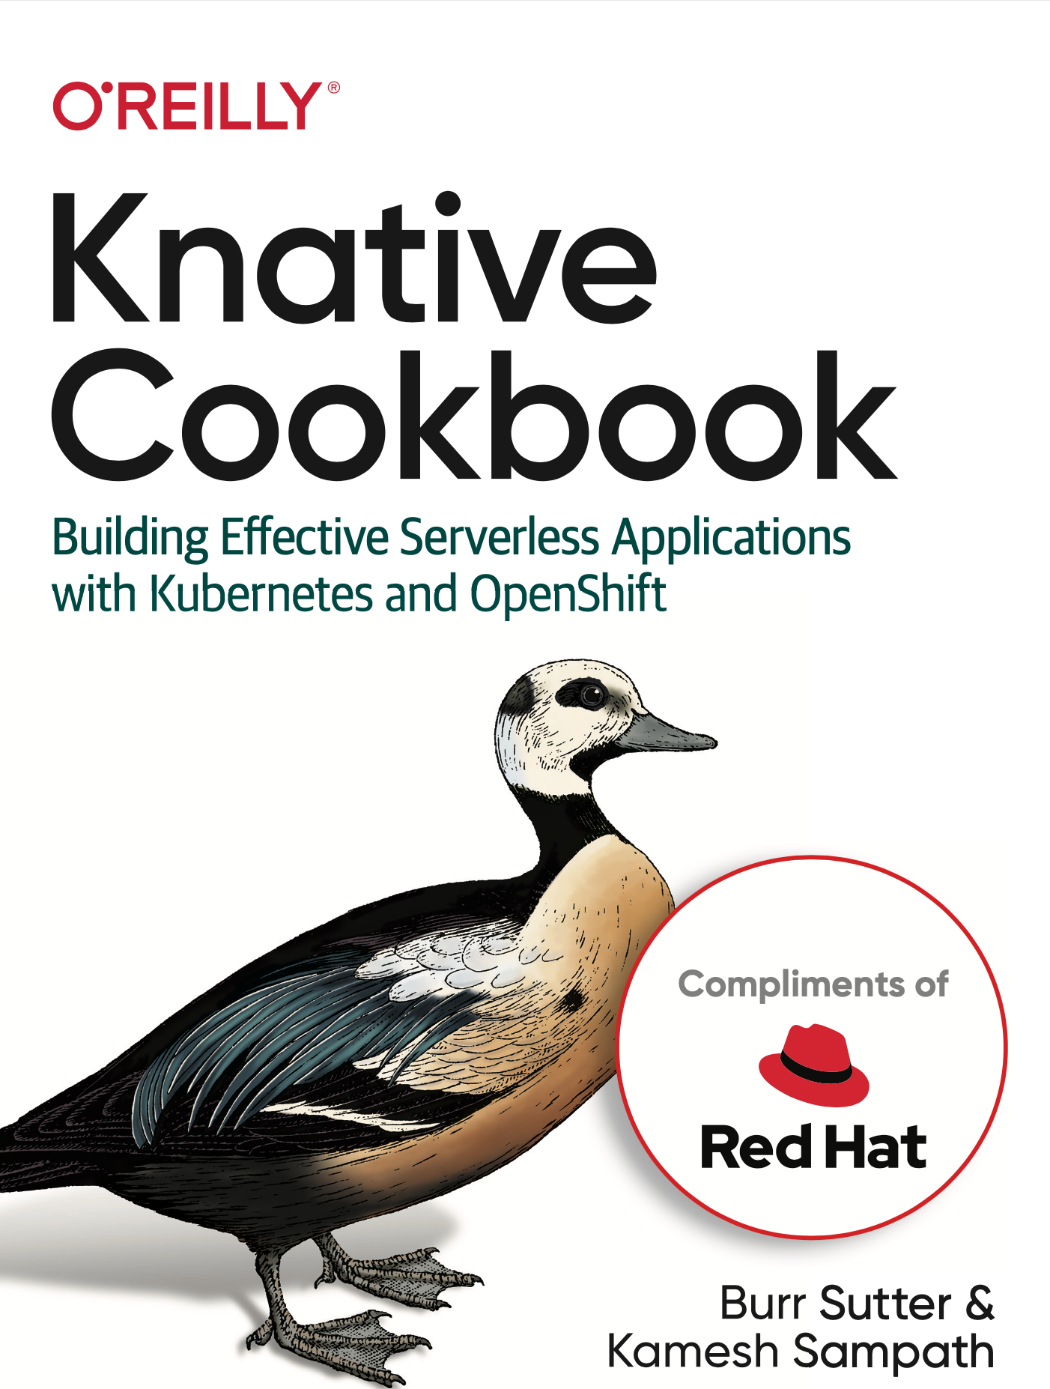
Coming Soon

Slide 65
The End

Slide 66
Backup Content

Slide 67
 | Kubernetes | OpenShift
Multi-container, multi-host scheduling | ✅ | ✅
Self-service provisioning | ✅ | ✅
Service discovery | ✅ | ✅
Persistent Storage | ✅ | ✅
Multi-tenancy |  | ✅
Networking (SDN) |  | ✅
Image Registry |  | ✅
Image Build Tools |  | ✅
Metrics |  | ✅
Log Aggregation |  | ✅
Ingress |  | ✅
UX: Console, Service Catalog, "oc" |  | ✅
Secured by Default |  | ✅
Notes:
Imagestreams plus Quay.io option
S2I & Pipelines
Metrics: Prometheus & Grafana
Log Aggregation: EFK: Elastic Search + Fluentd + Kibana
Ingress: haproxy: oc expose myservice, oc get routes
UX:
- Web-console
- "oc set probe"
- "oc new project"
- "oc new-app <image|git repo>"
- "oc start-build"
Service Catalog
Security:
SCC
SSO for the cluster, "oc login"
Security Response Team
https://thenewstack.io/critical-vulnerability-allows-kubernetes-node-hacking/
https://access.redhat.com/security/vulnerabilities/3716411
https://access.redhat.com/security/cve/cve-2018-1002105
https://access.redhat.com/security/vulnerabilities/runcescape
https://access.redhat.com/security/cve/cve-2019-5736

Slide 68
Kubernetes Ingress
Kube Native
App
Helmed
App
Kubernetes
Kubernetes CLI
Kubernetes API

Slide 69
Kubernetes Ingress
OpenShift Routes
Kube Native
App
Operated/Helmed
App
OpenShift Mesh/Istio
OpenShift Native
App
RHT Storage
Telemetry
(EFK/Profana)
Che
Knative
Specialized Java Services
---
Any Language Any Framework
Templates/S2I/BC
Quay
Kubernetes CLI
OpenShift CLI
Admin Console
Kubernetes API
OpenShift API
OpenShift
Kubernetes
OVN
RHEL
Ansible/Terraform/Operators

Slide 70
Strangler Strategy

Slide 71

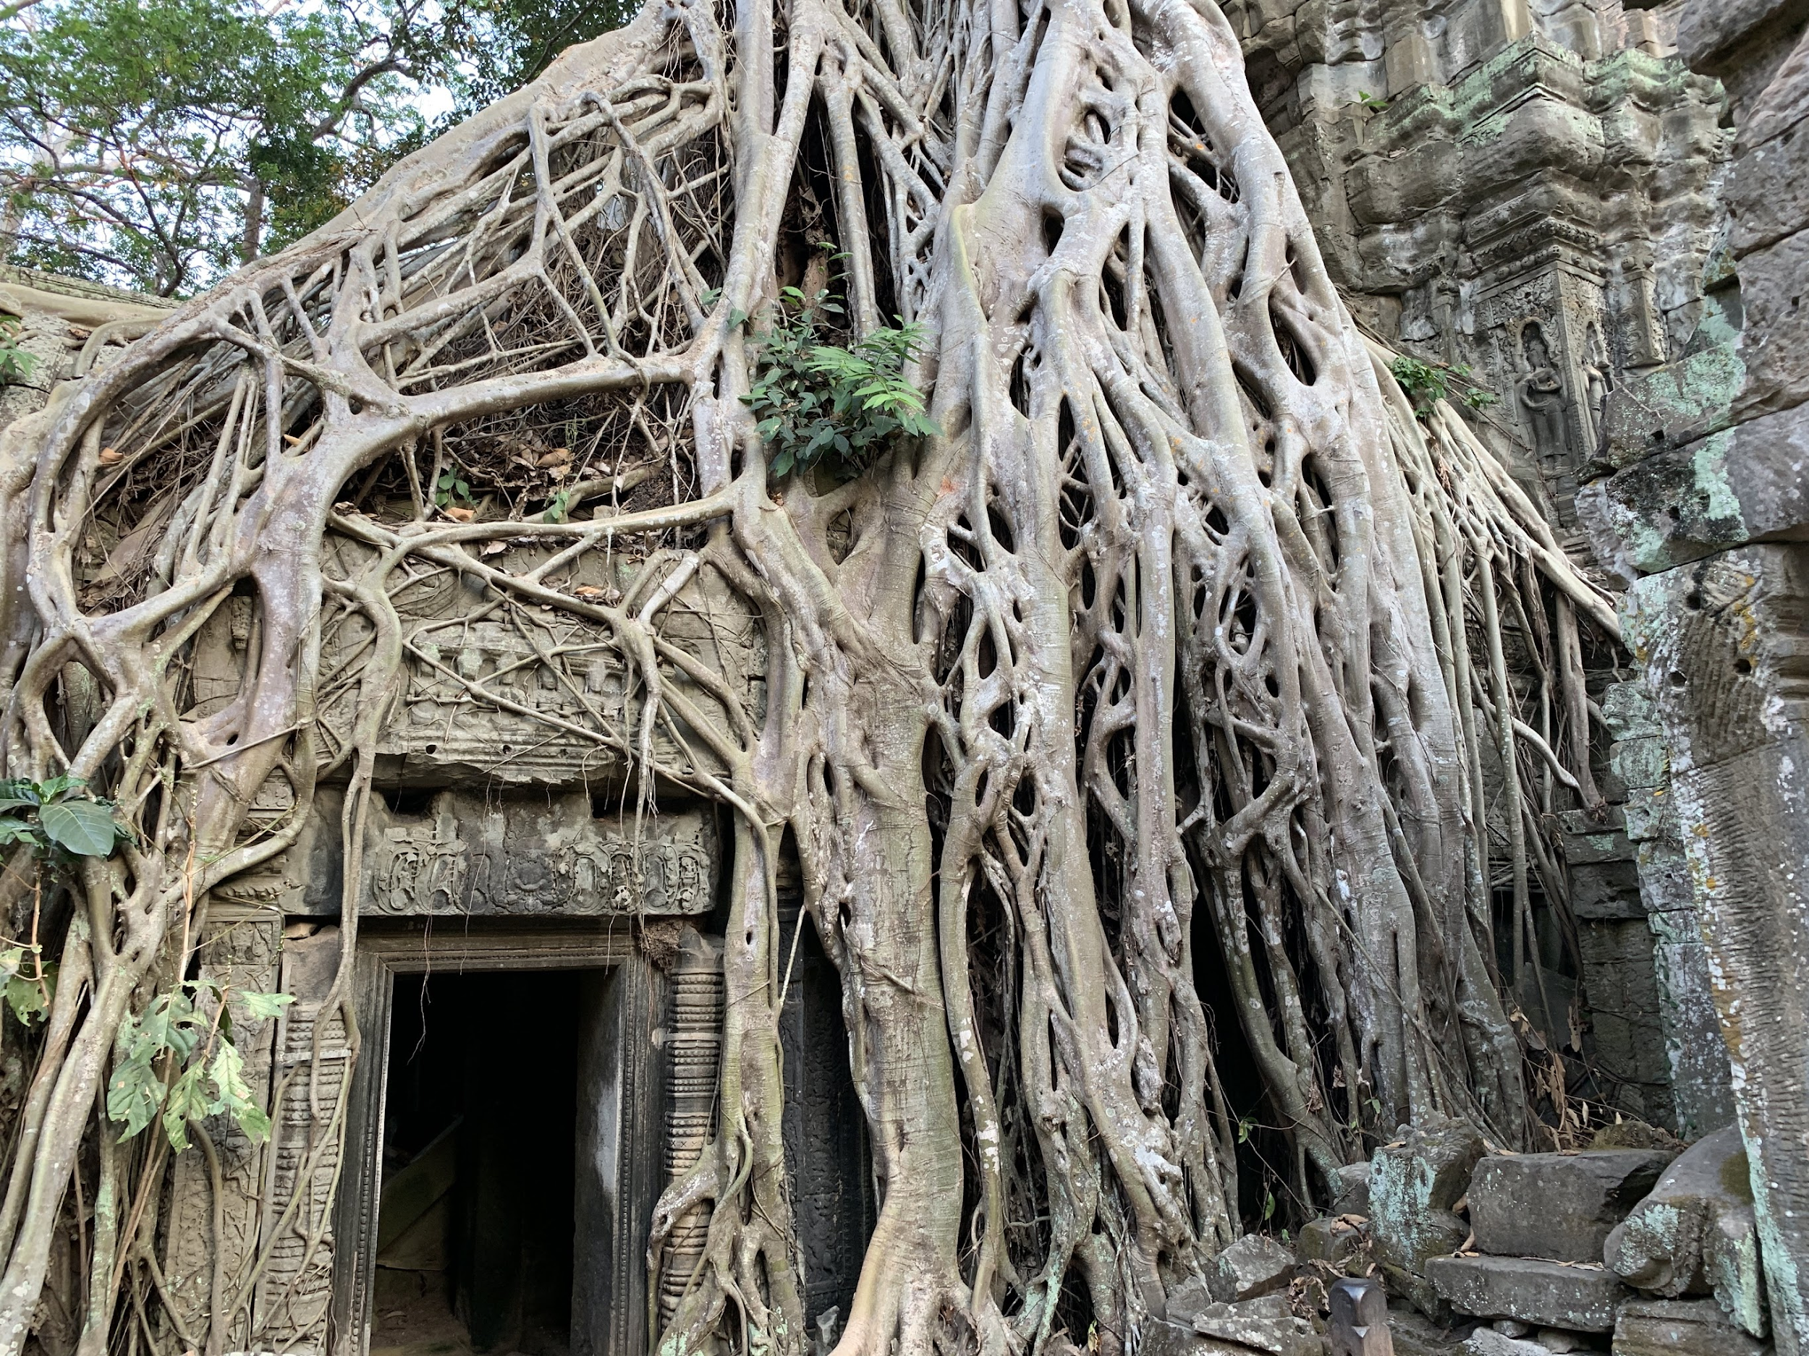

Slide 72
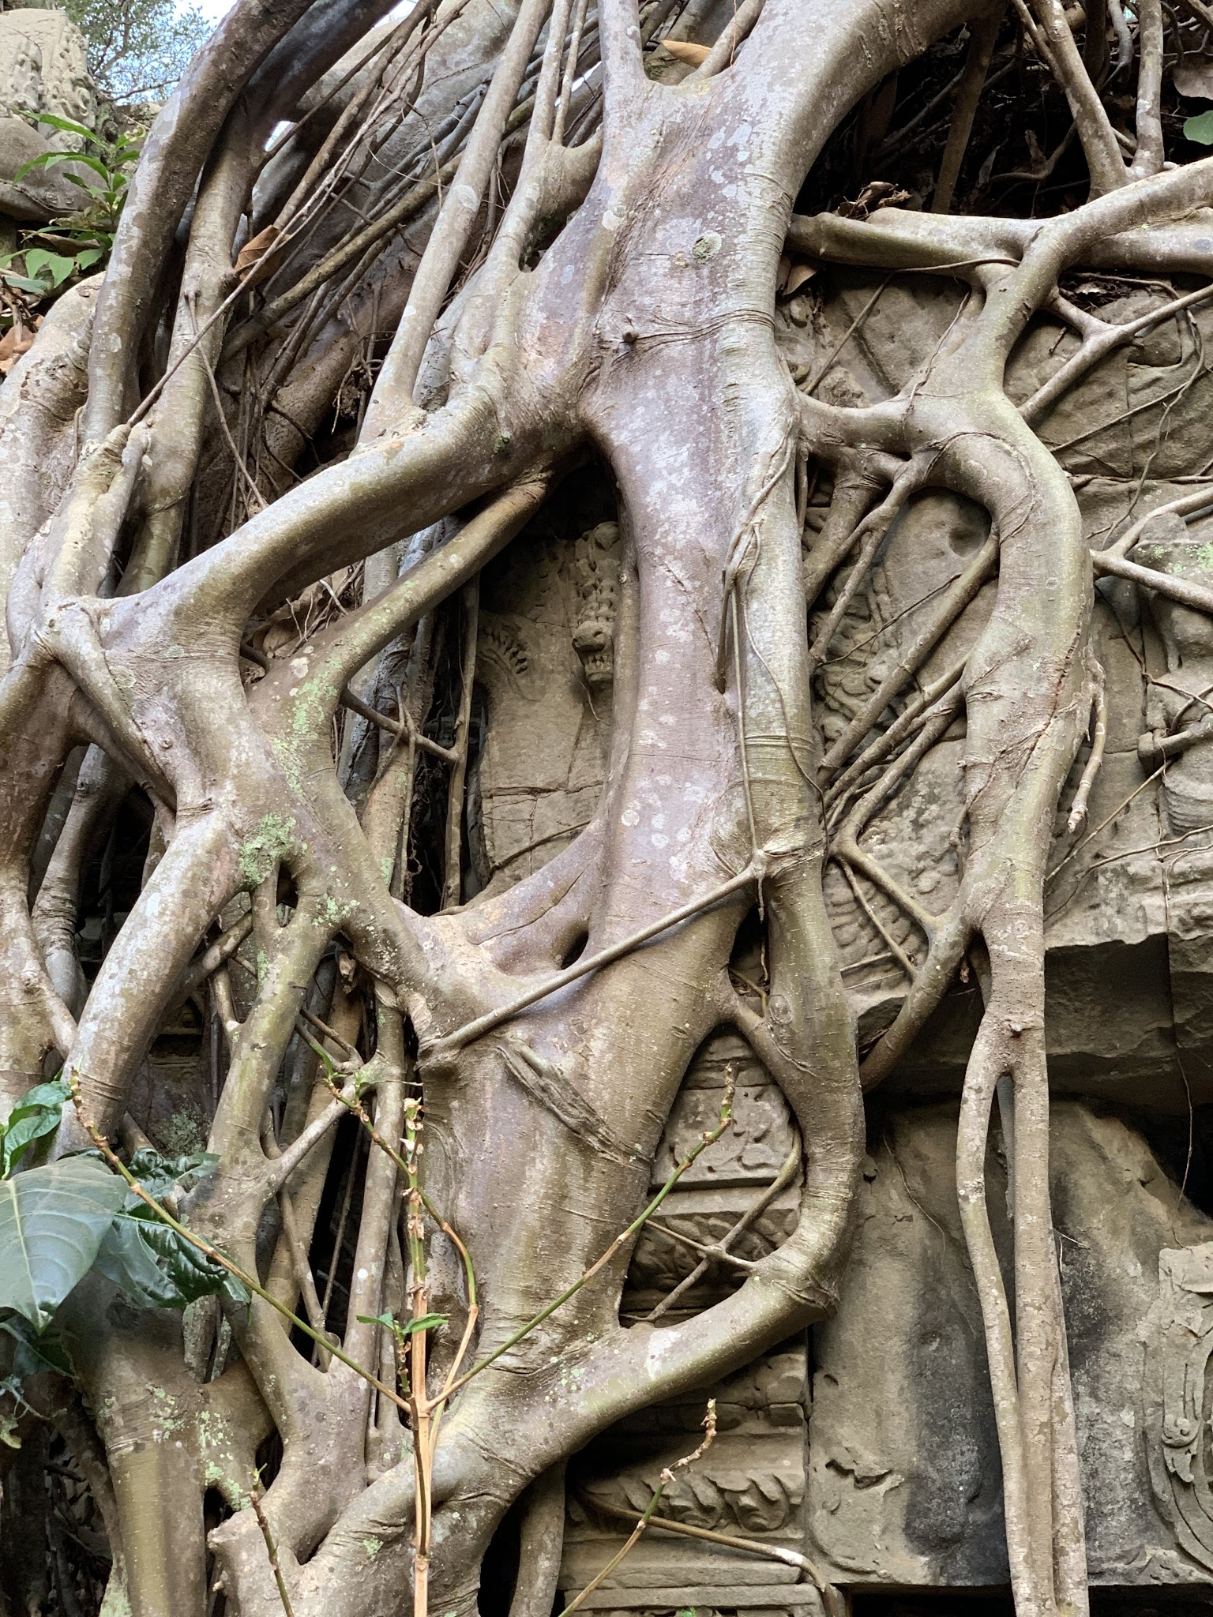


Slide 73

Application on Whiteboard

Slide 74
Whiteboard had 3 Tiers

Slide 75
UI, Logic, Data

Slide 76
Clean Architecture

Slide 77
Real Life: Non-Majestic Monolith

Slide 78









Large Team

Slide 79
Strangle

Slide 80
Strangle Hug

Slide 81
Friend Hug

Slide 82
Family Hug

Slide 83
Bear Hug

Slide 84
"Refactor"

Slide 85
Squeeze

Slide 86
Streamline

Slide 87
Embrace Others

